Slide 1



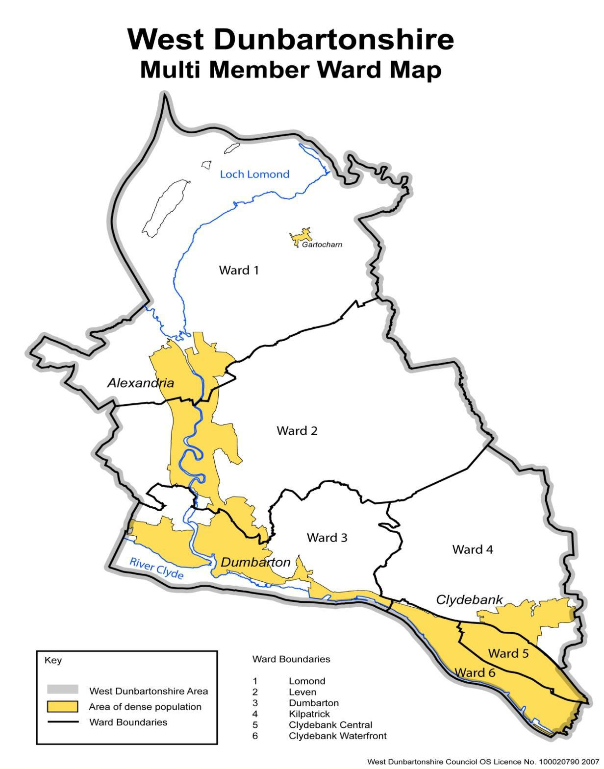
Priority Groups
West Dunbartonshire Employability Grants- Information Session 25-26
Clare Henry – Working 4U Coordinator

Slide 2
Funding Available
At present approx. £700,000 is available for commissioning.
Funds that will contribute to delivery in 25/26 are as follows:
UK Government Shared Prosperity
Scottish Government -No One Left Behind (NOLB)
Scottish Government - Parental Employment Support
Scottish Government - Specialist Employability Support*
*Specialist Employability Support
Specialist Employability Support is targeted at people with significant and on-going barriers to employment whose needs are not able to be met by mainstream employability support. Typically, they will require longer-term access to services including significant aftercare and in-work support to sustain employment. Participants may include, but are not limited to, disabled people including those with severe and enduring mental ill health, in recovery from addictions or experiencing long term health conditions and who require support from Key Workers with relevant experience and training.

Slide 3
Our Grant Outcomes and Principles
Both Scottish and Local Government are committed to the shared ambition of No One Left Behind and to tackling child poverty through a person-centred approach that is more flexible and responsive to the changing labour market, tackles inequalities and grows Scotland’s economy is needed now more than ever to shape a collective economic and wellbeing response.
Key Outcomes
Inactive and unemployed residents entering employment
Sustained employment for residents who have entered employment
Improved labour market situation for those in employment
Increasing income through employment for low-income families

Slide 4
Our Grant Outcomes and Principles
6 NOLB Principles
flexible and person-centred support
Be more straightforward for people to navigate
Be better integrated and aligned with other services, particularly with health, justice and housing provision
Provide pathways into sustainable and fair work
Be driven by evidence, including data and the experience of users
Support more people – particularly those facing multiple barriers – to move into the right job, at the right time

Slide 5
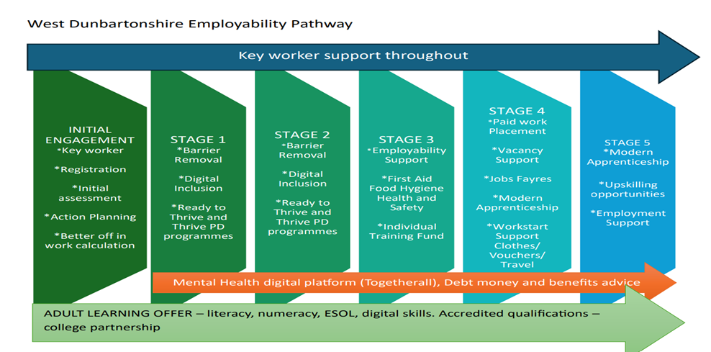
Working 4U Employability services

Slide 6
Priorities for West Dunbartonshire
Funder Priorities – Economically Inactive, Vulnerable Young people, Ethnic Minorities, Disabilities, Parents
Data analysis- reach, barriers
Internal Evaluation with core W4U Employability staff

Slide 7
Priorities for West Dunbartonshire
7 themes –
Ethnic Minorities – English Language Support
People with disabilities
Families facing poverty
Community Justice
Vulnerable Young People
Vocational Activity
Health and wellbeing Support

Slide 8
What Type of Provision Are We Looking For?
Priority Group(s) and Themes | Rationale/evidence of need /useful data | Pipeline Stages | Fundable Provision
Ethnic Minorities - People for whom a lack of English language skills is impacting on their ability to progress into work | Housing, employability, college and community learning services report an ongoing high demand for English language support and waiting lists. Employability services report a significant increase in the numbers of clients from minority ethnic groups engaging often with low English language skills, a key barrier to employment. CLD and the local college deliver ESOL however our needs assessment for employability clients suggest that there is a need for conversational classes/support, both generic as well as sector specific. | 1/2 | 1. Innovative and effective programmes that develop the English-speaking skills of refugees, asylum seekers, or other minority groups to enable them to access and sustain employment. The key need is to develop participants conversational English in suitable learning environments where participants with a range of abilities can develop confidence and ability.

Slide 9
What Type of Provision Are We Looking For?
Priority Group(s) and Themes | Rationale/evidence of need /useful data | Pipeline Stages | Fundable Provision
Disabilities – People with disabilities or long-term health conditions | Of the 887 individuals accessing employability support from Apr-Dec 2024 the figures below are a snapshot of those recording a disability or long-term condition. Autistic Spectrum Disorder/Condition 75 Learning difficulty 91 Learning disability 46 Physical disability 62 Sight/hearing/speech impairment 32 Long-term illness, disease or condition 157 Priority will be given to initiatives aimed at removing barriers to employment, such as providing accessible accommodation, offering skills training tailored to the needs of disabled individuals, and promoting inclusive hiring practices among local businesses. In addition to key worker support, Project Search commenced operation in West Dunbartonshire in 2024-25 and commissioned provision enhances our service offer to those with disabilities/long term conditions. | 1-5 | 2.1 All stage supported employment programme for people (all age) with disabilities as detailed opposite who wish to progress into paid employment. Support should include in work support as required. 2.2 Other specialist employment programmes supporting people with disabilities and long term conditions into employment.

Slide 10
What Type of Provision Are We Looking For?
Priority Group(s) and Themes | Rationale/evidence of need /useful data | Pipeline Stages | Fundable Provision
Community Justice - Justice System experienced residents | In Scotland, approximately 1 in 3 men and 1 in 10 women of working age have a criminal conviction. Engaging with the community justice experienced population is recognised as particularly challenging. Grant applicants are encouraged to clearly identify how they will do this. | Stage 1-5 | 3. Specialist support for people with experience of the Community Justice system which are impacting on access to employers/jobs. Working closely with Social Work colleagues to identify clients who will benefit from employability support across the justice process. Evidence suggests that access to specialist support and guidance to justice experienced residents and potential employers in relation to convictions and access to appropriate work experience placements will be a key aspect of delivery.

Slide 11
What Type of Provision Are We Looking For?
Priority Group(s) and Themes | Rationale/evidence of need /useful data | Pipeline Stages | Fundable Provision
Families facing poverty - Parents/kinship carers including those affected by in-work poverty. | 28% of children in West Dunbartonshire are living in poverty. A key focus of our parental employment work is to reach those parents more likely to be impacted by poverty: Single parents Families impacted by disability Parents under 25 Parents with children under 1 Parents with 3 or more children Ethnic minority parents Experience of the care system Understanding the prevalence of households likely to be affected by disadvantage is crucial for employability, learning and support initiatives. It is essential to address the specific challenges faced by these families in the area and tailor support services accordingly. | All stages | 4.1 Engagement, essential and Life-skills programmes for parents that will help to support the wider development needs of parents including wellbeing and social prescription and will positively impact on their employability journey. This should include 121 support and group work. 4.2 Other programmes supporting parents into employment or improved employment.

Slide 12
What Type of Provision Are We Looking For?
Priority Group(s) and Themes | Rationale/evidence of need /useful data | Pipeline Stages | Fundable Provision
Vulnerable Young People School leavers, unemployed or economically inactive young people including care experienced young people and young people who are neurodiverse. | Key workers support young people, and commissioned provision enhances the range of options available to help young people progress towards and into work. This includes transition key workers in schools and ‘Thrive’ and ‘Ready to Thrive’ personal development programmes. The Working4U ‘Thrive’ and ‘Ready to Thrive’ Programme is a stage 1 personal development programme supporting young people aged 16 – 24 to progress towards a positive destination of their choice. | Stages 1-4 Stages 1-4 | 5.1 Personal Social Development programmes for school leavers/ young people up to 29 years which provide training; essential skills development, qualifications, employment related skills and include work experience. 5.2 Programmes specifically for young people aged 16-29 years including foundation skills; industry specific training; work experience; job matching; access to Apprenticeship programmes (please detail the frameworks training aligns with) and in work support.

Slide 13
What Type of Provision Are We Looking For?
Priority Group(s) and Themes | Rationale/evidence of need /useful data | Pipeline Stages | Fundable Provision
Vocational Activity - residents requiring vocational skills and work experience to progress into employment | The LEP recognises the need to provide vocational skills training in sectors where there are likely to be vacancies over the coming year. The aspiration of the SEG is to support those gaining vocational skills to progress into related and sustainable work opportunities in West Dunbartonshire, or within other travel to work areas. We have an all age offer in Working4U with people requesting vocational training. (Working4U has the ability to offer vocational training in customer care and social care). Some of this can be met through accessing training on an individual basis however we require a wide range of relevant vocational courses for groups of clients to meet client and employer needs. This support should offer progressions for residents participating in wellbeing and personal development programmes. | 3/4 | Delivery of 4 -12-week vocational skills programmes/sector-based work academies, which are linked to local employers and evidenced work opportunities. Programmes must include industry recognised qualifications/certificates; a minimum of 2 weeks work experience and guaranteed interviews. Much of what we commission will be all age and open to all target groups however we need to ensure our provision meets the specific needs of our priority groups who may benefit from a more targeted and bespoke programme, in particular: Parents – who need training provision and jobs with school /parent friendly hours and conditions. School leavers up to 29yrs who require vocational programmes adapted to meet their specific needs and job opportunities including apprenticeships. Applicants may opt to deliver vocational programmes for all ages (no specific target group) and/or courses bespoke for parents or young people.

Slide 14
What Type of Provision Are We Looking For?
Priority Group(s) and Themes | Rationale/evidence of need /useful data | Pipeline Stages | Fundable Provision
Health and Wellbeing support | 52% of those engaging with employability services from Apr-Dec 2024 report a health issue including mental health. Evidence suggests the most common issues relate to mental health and that these issues impact on clients’ ability to engage and progress towards and into employment. | n/a | Delivery of wellbeing courses/programmes that will positively impact on participants employability journey.

Slide 15
What Type of Provision Are We Looking For?
Milestone | Date
Grant opens for applications | Wednesday 26th March 2025
Information sessions for potential applicants – please attend 1 session | Monday 31st March 11.30am on Teams Wednesday 2nd April 11.30am on Teams
Q&A open | Wednesday 26th March 2025
Q&A closure | Friday 11th April 2025
Application deadline | Friday 18th April noon
Assessment process | W/C Monday 21st April
Application outcomes notified | W/C Monday 21st April
Delivery end | End March 2026

Slide 16
The Application Form

